Slide 1
Design Principles

Slide 2
Design rules and principles
3 types:
Design Principles
Design Standards
Heuristics and Guidelines

Slide 3
Principles
General, high level, design knowledge
Many textbooks full of design principles
Principles are based on knowledge from many fields – particularly psychology, graphic design, cultural studies.
abstract guidelines (principles) applicable during early design activities
detailed guidelines (style guides) applicable during later design activities

Slide 4
Standards
‘Rules’ – with high authority. Specific to a particular type of design (windows applications, aircraft cockpit displays)
set by national or international bodies to ensure compliance by a large community of designers.
hardware standards more common than software.
Standards have a high authority and great amount of detail. In some domains (e.g. safety critical design) failure to apply standards can lead to disaster (or a legal case..)

Slide 5
Guidelines and heuristics
Turn general principles into practical guidance in a particular design domain
Useful check list for good design
Better to design using these than using nothing!

Slide 6
Nielsen’s 10 Heuristics: 1-5
Visibility of system status: The system should always keep users informed about what is going on, through appropriate feedback within reasonable time.
Match between system and the real world: The system should speak the users' language, with words, phrases and concepts familiar to the user, rather than system-oriented terms. Follow real-world conventions, making information appear in a natural and logical order.
User control and freedom: Users often choose system functions by mistake and will need a clearly marked "emergency exit" to leave the unwanted state without having to go through an extended dialogue. Support undo and redo.
Consistency and standards: Users should not have to wonder whether different words, situations, or actions mean the same thing. Follow platform conventions.
Error prevention: Even better than good error messages is a careful design which prevents a problem from occurring in the first place. Either eliminate error-prone conditions or check for them and present users with a confirmation option before they commit to the action.

Slide 7
Nielsen’s 10 Heuristics: 6-10
6. Recognition rather than recall: Minimize the user's memory load by making objects, actions, and options visible. The user should not have to remember information from one part of the dialogue to another. Instructions for use of the system should be visible or easily retrievable whenever appropriate.
7. Flexibility and efficiency of use: Accelerators -- unseen by the novice user -- may often speed up the interaction for the expert user such that the system can cater to both inexperienced and experienced users. Allow users to tailor frequent actions.
8. Aesthetic and minimalist design: Dialogues should not contain information which is irrelevant or rarely needed. Every extra unit of information in a dialogue competes with the relevant units of information and diminishes their relative visibility.
9. Help users recognize, diagnose, and recover from errors: Error messages should be expressed in plain language (no codes), precisely indicate the problem, and constructively suggest a solution.
10. Help and documentation: Even though it is better if the system can be used without documentation, it may be necessary to provide help and documentation. Any such information should be easy to search, focused on the user's task, list concrete steps to be carried out, and not be too large.

Slide 8
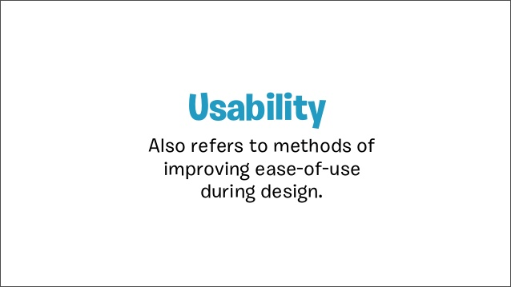

Slide 9
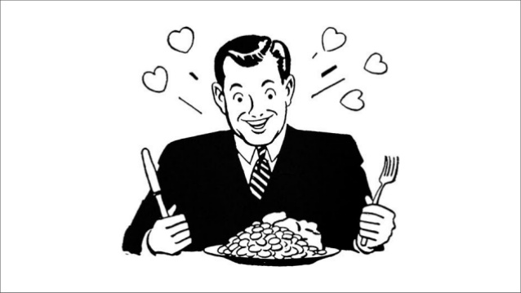

Slide 10
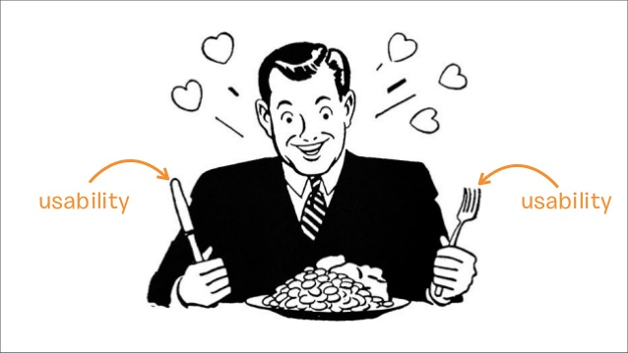

Slide 11
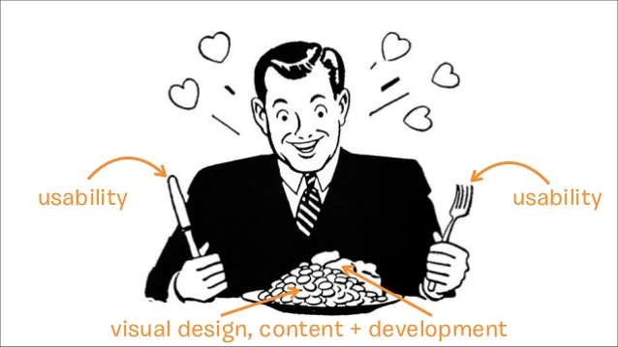

Slide 12
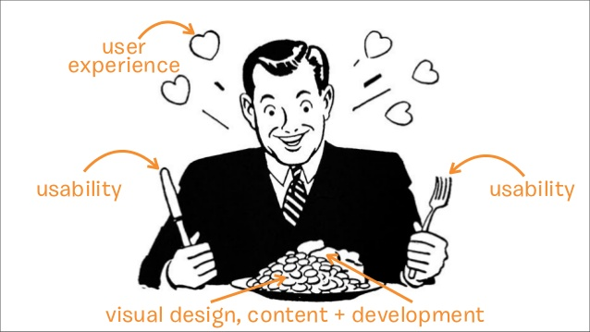

Slide 13
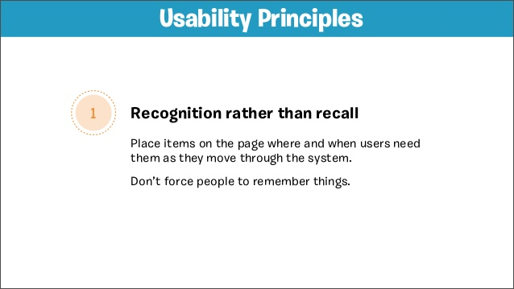

Slide 14
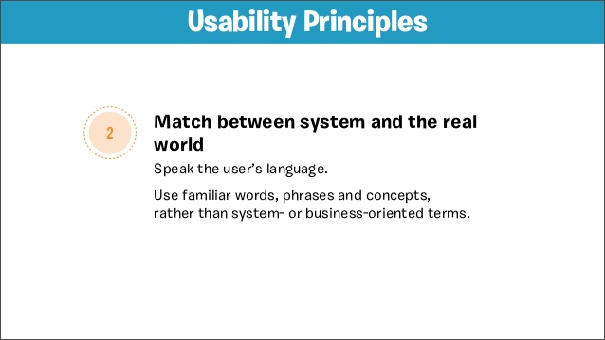


Slide 15
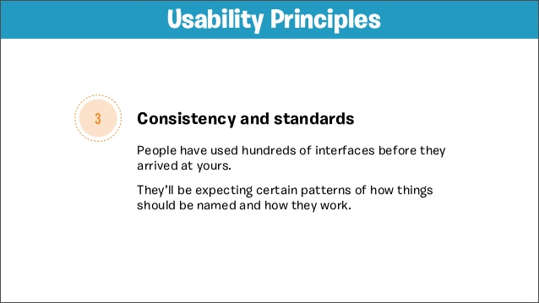

Slide 16
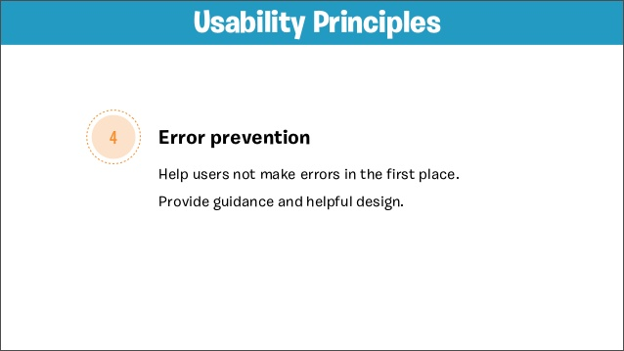

Slide 17
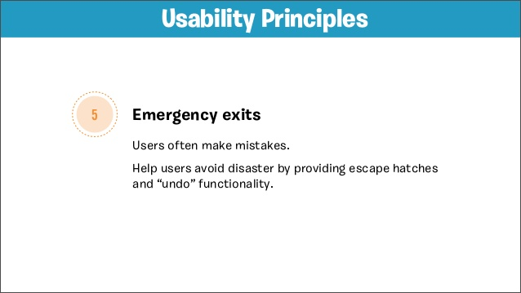

Slide 18
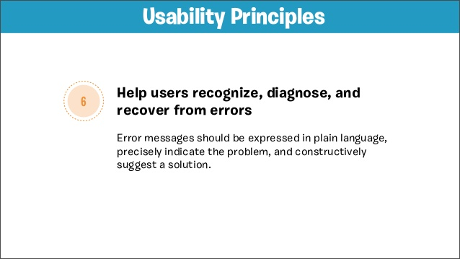

Slide 19
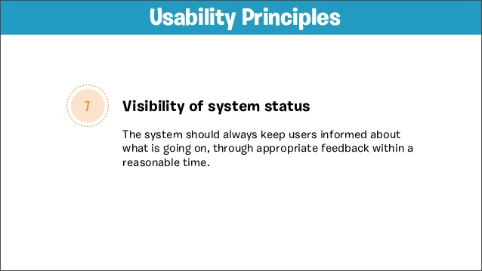

Slide 20
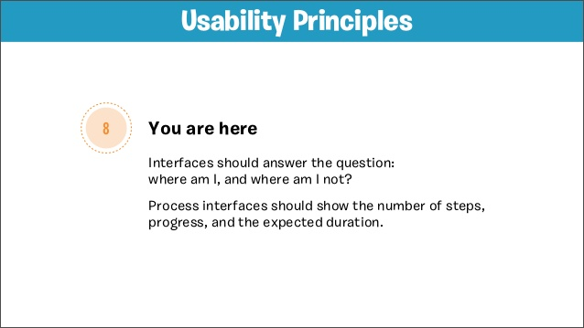

Slide 21
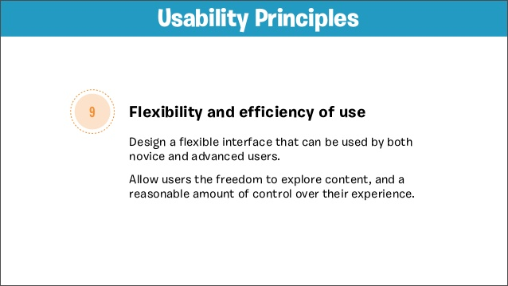

Slide 22
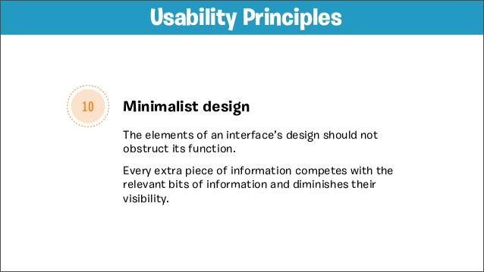

Slide 23
Interface design ‘worlds’

Slide 24
World 1: Application GUI’s
Application interfaces for Windows, Mac OS, Linux X-Windows.
Use published standards (confusingly called style guides)
Windows standards strive for consistency of operation in applications that come from different vendors
Visual design is usually tied to resources that come with the OS (.dll file with buttons, widgets, checkboxes, sliders)
Development toolkits (Visual Basic toolkit, J Builder, .net development suite) include interface builders that call resources from the interface .dll
Ignoring the standards can lead to failures of interoperability between programmes, or user confusion.

Slide 25
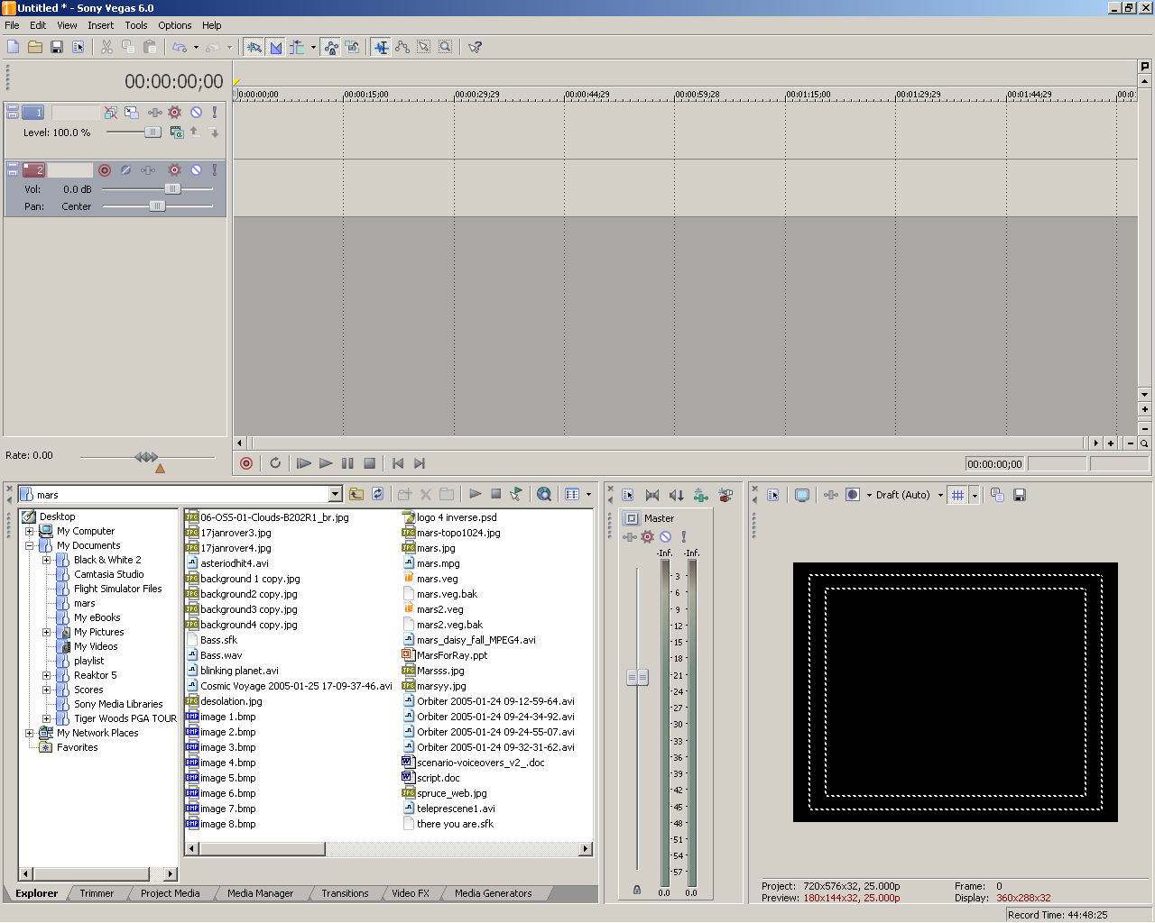
Sony Vegas uses Windows objects for its interface

Slide 26
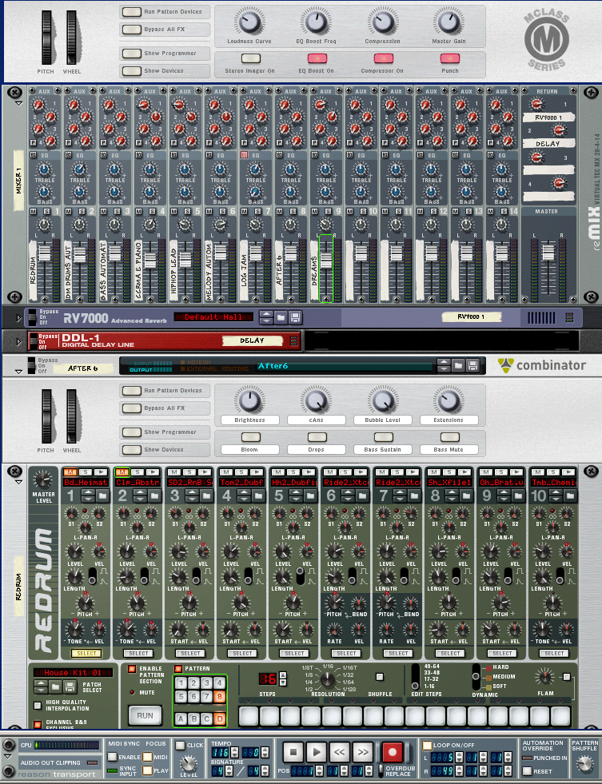
Propellerheads Reason rejects windows widgets to make its interface look more like hardware musical equipment.

Slide 27
World 2: Web Interfaces
Standards proposed by W3C, but usually ignored (e.g. accessibility)
Good design relies on the application of heuristics and successful patterns (e.g. the Amazon.com model for e-commerce)
Variety of design on the web can be chaotic, amateurish, disastrous.
However, web design can be highly creative and innovative.

Slide 28
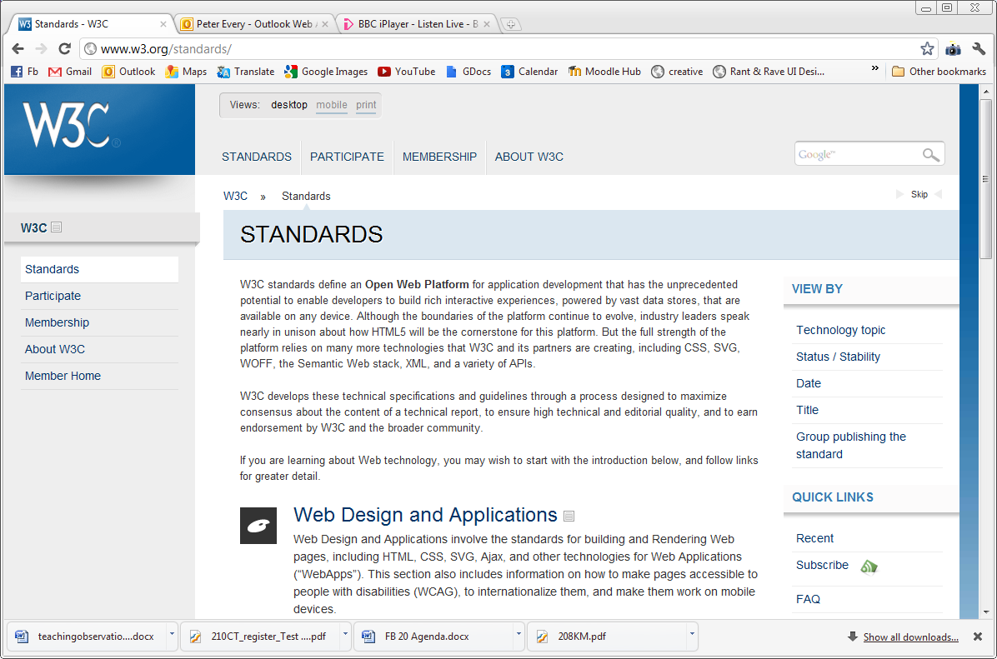
W3C introduces open standards for accessible web pages

Slide 29
World 3: Device Interfaces
Designing interactions for devices as diverse as mobile phones, MP3 players, cooker controls, aircraft cockpits - is perhaps the most challenging ‘world’ for the interface designer.
Standards are few and far between (mainly for safety critical systems) hence the huge number of examples on baddesigns.com
Design patterns are most often used – a successful design spawns a multitude of copies
Because devices are tactile, the role of ergonomics is central in their design.

Slide 30
Design Principles
Over the years many principles of good interactive system design have been developed.
Design principles can be very broad
such as ‘make things visible’
They can be more specific
such as ‘provide clearly marked exits’
There are also good design principles that derive from psychology
such as ‘minimize memory load’ (i.e. do not expect people to remember too much).

Slide 31
Principles and Patterns
The application of design principles has led to established patterns of interaction in certain circumstances
such as the ‘undo’ command in a Windows application, or the ‘back’ button on a Web site
the greying out of inappropriate options on menus.
Design principles can
guide the designer during the design process
can be used to evaluate and critique prototype design ideas.

Slide 32
Twelve Principles for good human-centred interactive systems design proposed by Benyon, Turner & Turner in ‘Designing Interactive Systems’
Learnability
1. Visibility
2. Consistency
3. Familiarity
4. Affordance
Ease of Use
5. Navigation
6. Control
7. Feedback
Robustness
8. Recovery
9. Constraints
Accommodation
10. Flexibility
11. Style
12. Conviviality

Slide 33
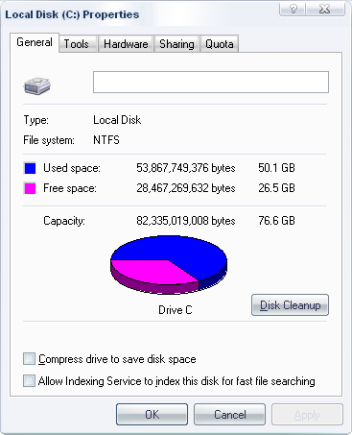
Principle 1 - Visibility
Try to ensure that things are visible so that people can see what functions are available and what the system is currently doing.
This is an important part of the psychological principle that it is easier to recognize things than to have to recall them. (Norman)
Consider making things ‘visible’ through the use of sound and touch.

Slide 34
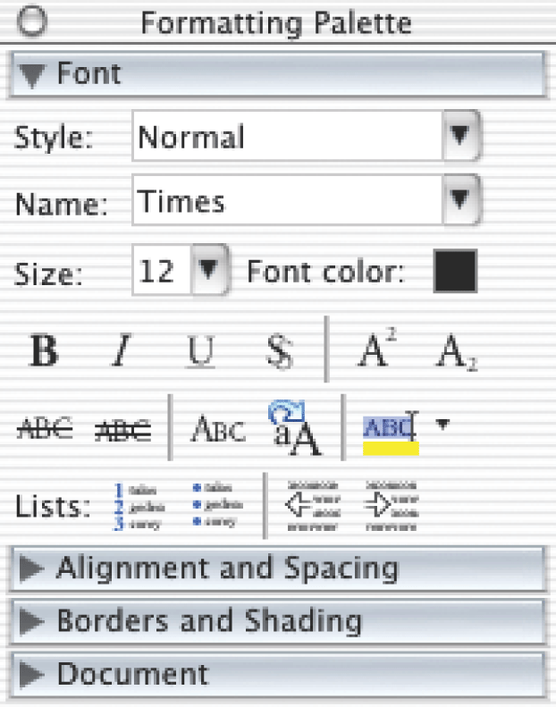
The common commands and defaults are made visible
Other commands are observable by using the drop down menus
Visibility and sensible grouping makes people aware of other options
A formatting palette in MacOS10

Slide 35
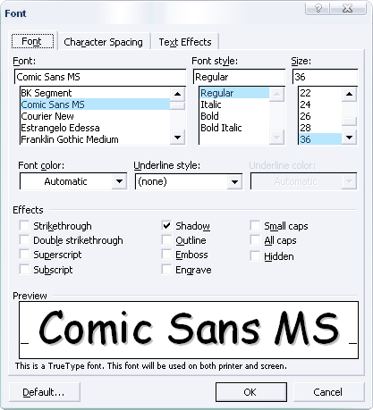
A formatting palette in Windows XP

Slide 36
Principle 2 - Consistency
Be consistent in the use of design features
Be consistent with similar systems and standard ways of working.
This involves being consistent both internally to the system and externally as the system relates to things outside of it.
Physical consistency is ensuring consistent behaviours and consistent use of colours, names, layout and so on.

Slide 37
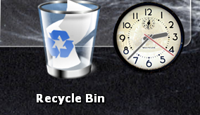
Principle 3 - Familiarity
Use language and symbols that the intended audience will be familiar with.
Where this is not possible because the concepts are quite different from those people know about, provide a suitable metaphor
to help them transfer similar and related knowledge from a more familiar domain.

Slide 38
Principle 4 - Affordance
Design things so it is clear what they are for;
for example make buttons look like buttons so people will press them.
Affordance refers to the properties that things have (or are perceived to have) and how these relate to how the things could be used.
Buttons afford pressing, chairs afford sitting on and post-it notes afford writing a message on and sticking next to something else.
Affordances are culturally determined.

Slide 39
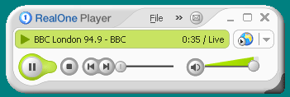
Examples of Affordance: A Media Player
Buttons on media players have affordance - they suggest what they can be used because we are familiar with similar devices
The RealOne Player ® with two slider controls.

Slide 40
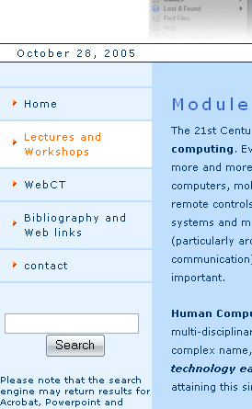
Principle 5 - Navigation
Provide support to enable people to move around the parts of the system; maps, directional signs and information signs.
Menus are often used for navigation, signs (labels) indicate where else you can go in the system.

Slide 41
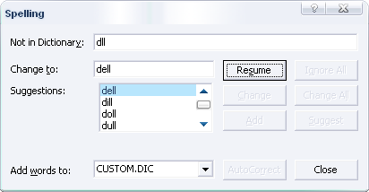
Principle 6 - Control
Make it clear who or what is in control and allow people to take control.
Control is enhanced if there is a clear, logical mapping between controls and the effect that they have.
Also make clear the relationship between what the system does and what will happen in the world outside the system.

Slide 42
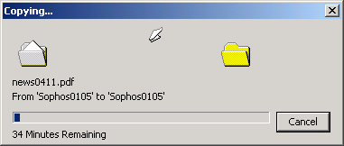
Principle 7 - Feedback
Rapidly feed back information from the system to people so that they know what effect their actions have had.
Constant and consistent feedback will enhance the feeling of control.
E.g. Feedback from playing a guitar, Pressing a button or pulling a lever is instant

Slide 43

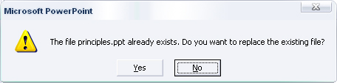
Robustness
Principle 8 - Recovery
enable recovery from actions, particularly mistakes and errors, quickly and effectively.
Principle 9 - Constraints
provide constraints so that people do not try to do things that are inappropriate.
In particular people should be prevented from making serious errors through properly constraining allowable actions and seeking confirmation of dangerous operations.

Slide 44
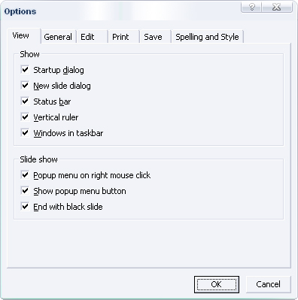
Principle 10 - Flexibility
Allow multiple ways of doing things
so as to accommodate users with different levels of experience and interest in the systems.
Provide people with the opportunity to change the way things look or behave
so that they can personalize the system.

Slide 45
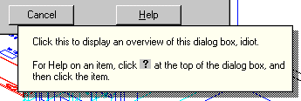
Aesthetics
Principle 11 - Style
designs should be stylish and attractive
Principle 12 - Conviviality
Interactive systems should be polite, friendly, and generally pleasant.
Nothing ruins the experience of using an interactive system more than an aggressive message or an abrupt interruption.
Conviviality also suggests joining in and using interactive technologies to connect and support people.

Slide 46
Try not to say ‘user friendly’: say ‘USABLE’
To claim that an interface is ‘user friendly’ is subjective and not testable.
To claim that an interface is USABLE requires that we measure ‘usability’ with some predetermined metrics/measures.
This is much more scientific (and legally sound too)

Slide 47
One definition of usability
ISO 9241 (part 11) defines usability as:
“The extent to which a product can be used by specified users to achieve specified goals with effectiveness, efficiency, and satisfaction in a specified context of use”
…we could add ‘learnability’ to this list.

Slide 48
Effectiveness: Can you actually do a specified task?
Efficiency: Can you do it quickly, without getting bored or frustrated?
Satisfaction: Is it fun, or at least pleasant to use?
Learnability: Can you use it without constantly reaching for the manual or asking for help.
Each of these concepts needs a different measuring method. E.g:
- Efficiency: Time to complete task
- Effectiveness: percentage of tasks completed in test.
- Satisfaction: Rating the application in a questionnaire.

Slide 49
Usability Metrics:
Task completion
Number of errors made
Time taken
Number of times frustration is expressed
Ratio of optimum click path to actual click path in a website (e.g. navigation should take 2 clicks but user completed task in 11 clicks.
Many others

Slide 50
Usability: Why should we care?
“The lack of usability of software and the poor design of programs are the secret shame of the [software] industry. … Computing professionals themselves should take responsibility for creating a positive user experience. Perhaps the most important conceptual move to be taken is to recognize the critical role of design, as a counterpoint to programming, in the creation of computer artifacts.”
Mitch Kapor in ‘Bringing Design to Software’ (Edited by Terry Winograd)

Slide 51
Three approaches to understanding the importance of usability
The Paradigm Shift
The case for Usability
Constraints on implementing Usability

Slide 52
Paradigm Shift
In the last 25 years the focus in software design has moved from:
Fitting the user to the interface
to
Fitting the interface to the ‘person’
25 years ago - Computing was a ‘specialist industry’ producing ‘specialist tools’
Required Mathematics / Computing graduates.

Slide 53
Paradigm Shift
Change in computer use:
Mainframes in 1970’s ………..... Expert users
Domestic PC, Mobiles, TV’s….. non-expert users
Proportionally more of the code in a computer application is devoted to the user interface - (McIntyre et al 1990)
20% in 1980 (command line)
50% in 1990 (GUI)
about 80 - 90 % in web design now

Slide 54
Paradigm Shift
Devices are now used in a much broader set of contexts:
Globalisation - broadening the device market across the planet.
Localisation - culturally specific interfaces (particularly the web – how many localised amazon sites are there? .com / .co.uk / .de / .es).
Personalisation – the customisability and ‘preferences setting’ that users expect from their devices.
Interoperability – growing expectations that devices will work together.

Slide 55
Is usability a new name for an old practice?
We find concerns about the intelligibility of interfaces in disciplines as broad as:
Human Computer Interaction
Psychology
Graphic Design
Cultural Studies
…However, these disciplines are concerned with the understanding of human action at an explanatory level (the WHY? Question).
Research output from these fields often gives very few clues as to ‘what to do’ with the information they discover.

Slide 56
Usability is focused on ACTION.
Not so concerned with WHY an interface fails but WHAT is to be changed to make it work: Action oriented research:
Field observation / testing
Engagement with users
Prototype building
HCI | Usability
Why | How
Focus on theoretical explanation | Focus on practical solutions
Academic | Commercial

Slide 57
Constraints on implementing Usability
Design Inertia
Design traditions and perspectives
Legal, contractual and process constraints

Slide 58
Constraints on implementing Usability
Design Inertia
Standards and traditions ‘enshrine’ design approaches and objects – making it very difficult to ‘revolutionise’ design on the basis of usability. (the costs are too great, the staff are already trained in the ‘old system’)
Example: The QWERTY keyboard.

Slide 59
Design traditions and perspectives
Different types of designer ask very different types of question:
Software perspective - System / technical design - how hardware and software fit together to produce a functional system. Concentration is on functionality.
System centred design questions:
What can be built on this platform?
What can I create from the available tools?
How do I as a programmer think the system should be designed?

Slide 60
Design traditions and perspectives
Different designers ask very different types of question:
Graphic design - often used to produce a sense of ‘style’ or corporate identity. Concentration is on aesthetics / Look and feel.
Graphic centred design questions:
How do I create a good looking site?
What can I create from the available tools?
How do I as a graphic designer think the system should be designed?

Slide 61
Summary of Norman’s Principles
Visibility – The more visible functions are, the more likely users will be able to know what to do next. In contrast, when functions are "out of sight," it makes them more difficult to find and know how to use.
Feedback –about sending back information about what action has been done and what has been accomplished, allowing the person to continue with the activity. Various kinds of feedback are available for interaction design-audio, tactile, verbal, and combinations of these.
Constraints –refers to determining ways of restricting the kind of user interaction that can take place at a given moment. There are various ways this can be achieved.
Mapping –relationship between controls and their effects in the world. Nearly all artefacts need some kind of mapping between controls and effects, whether it is a flashlight, car, power plant, or cockpit. An example of a good mapping between control and effect is the up and down arrows used to represent the up and down movement of the cursor, respectively, on a computer keyboard.
Consistency –designing interfaces to have similar operations and use similar elements for achieving similar tasks. … a consistent interface is one that follows rules, such as using the same operation to select all objects. … a consistent operation is using the same input action to highlight any graphical object at the interface, such as always clicking the left mouse button. Inconsistent interfaces …allow exceptions to a rule.
Affordance –attribute of an object allows people to know how to use it. For example, a mouse button invites pushing (in so doing acting clicking) by the way it is physically constrained in its plastic shell. At a very simple level, to afford means "to give a clue" (Norman, 1988). When the affordances of a physical object are perceptually obvious it is easy to know how to interact with it. [In Preece, J., Rogers, Y., Sharp, H. (2002), Interaction Design: Beyond Human-Computer Interaction, New York: Wiley, p.21]

Slide 62
The Missing questions….
…. Are user centred design questions:
What do users want to do with this software?
How can I make this software easier to use?
How do I make the software usable by the widest number of people?
User Centred Design?
"To users, the user interface is the system.“ (Deborah Hix and H. Rex Hartson, " Developing User Interfaces", 1993)

